Slide 1
R in marketing surveys - how to speed up the analysis of open ended questions
Agnieszka Otręba - Szklarczyk
September 29, 2019
Why R 2019

Slide 2
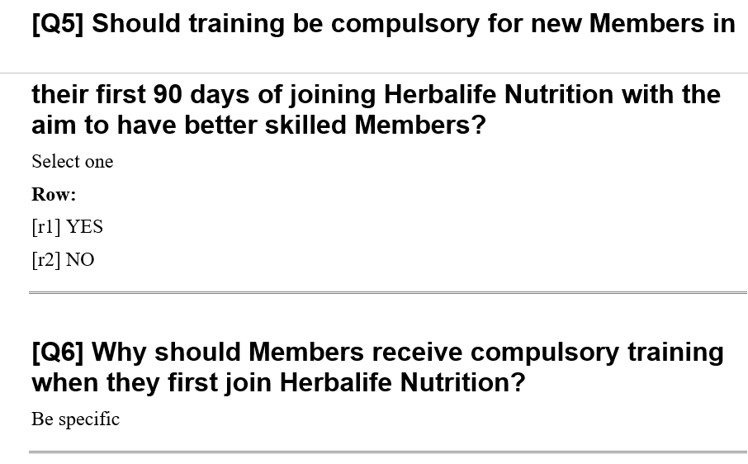
Open-ended questions

Slide 3
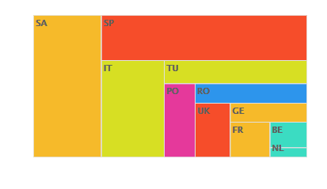
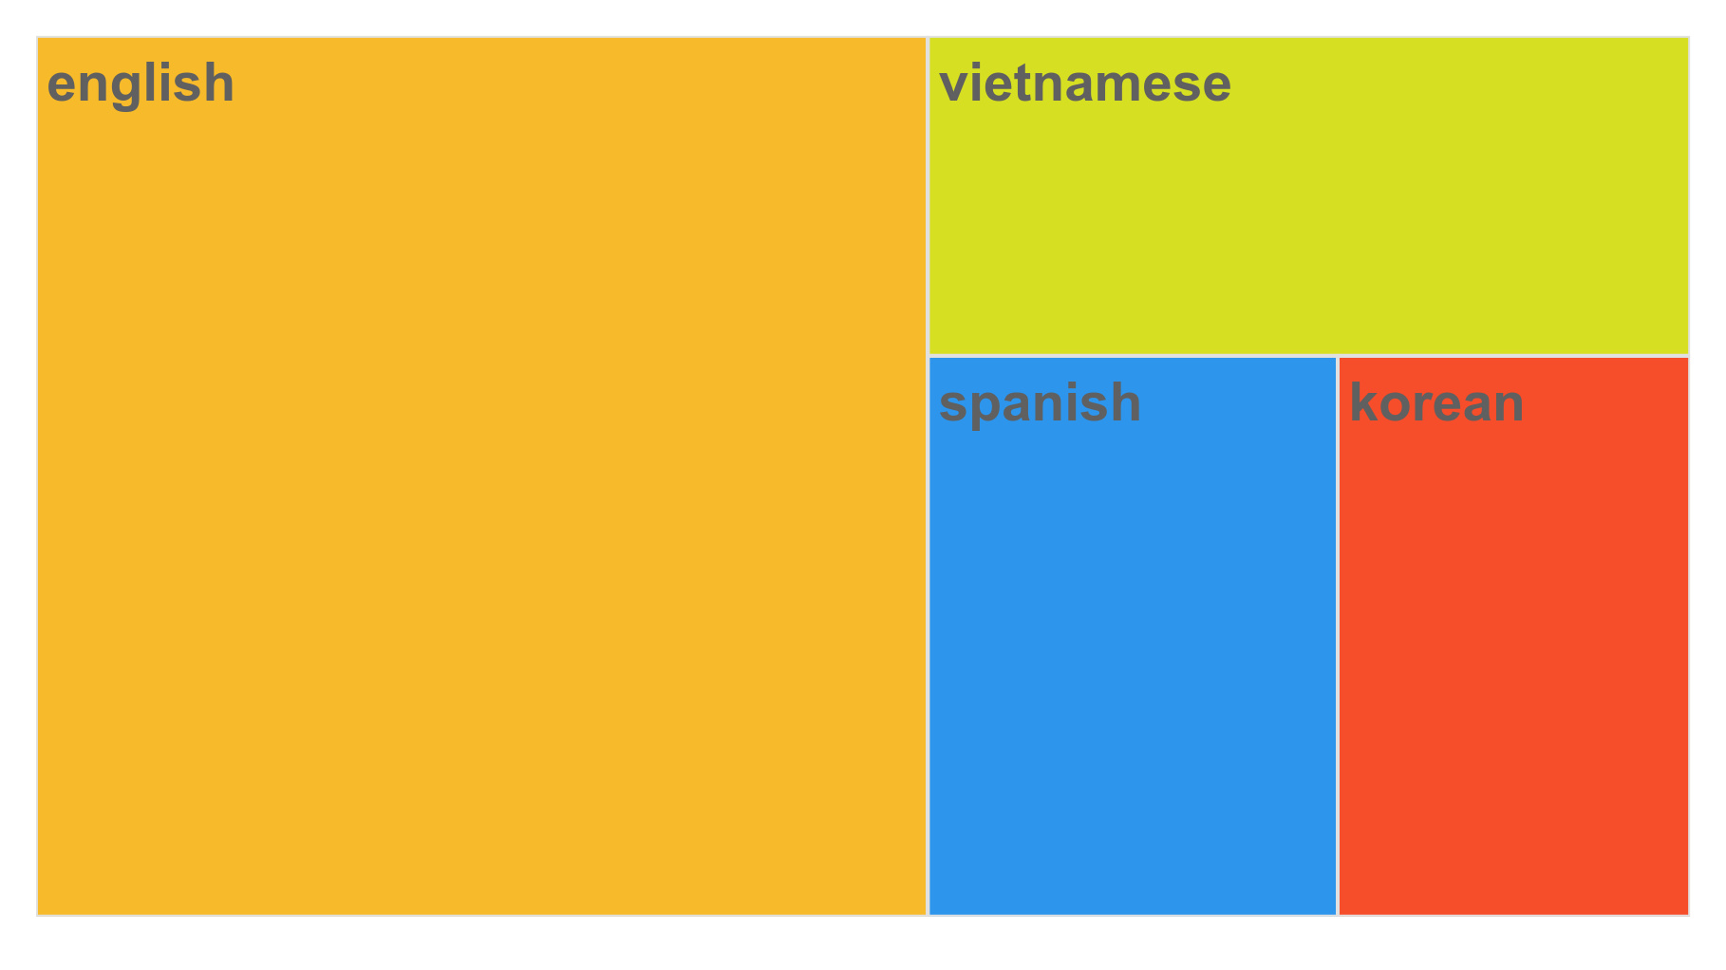
Many surveys … large samples … a huge amount of opened… One week of work
12001
5005

Slide 4

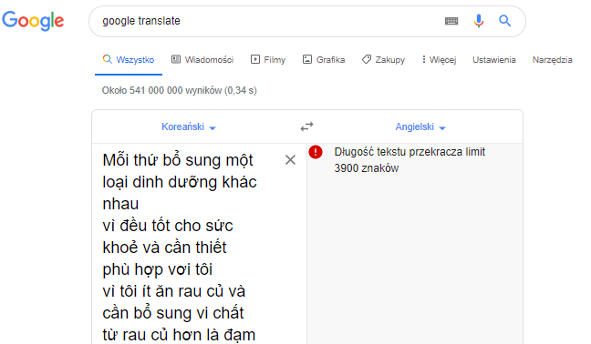
Many surveys … large samples … a huge amount of open-ended questions… One week of work
12001
5005

Slide 5
What we can do?

Slide 6


Slide 7

Any heroes?

Slide 8
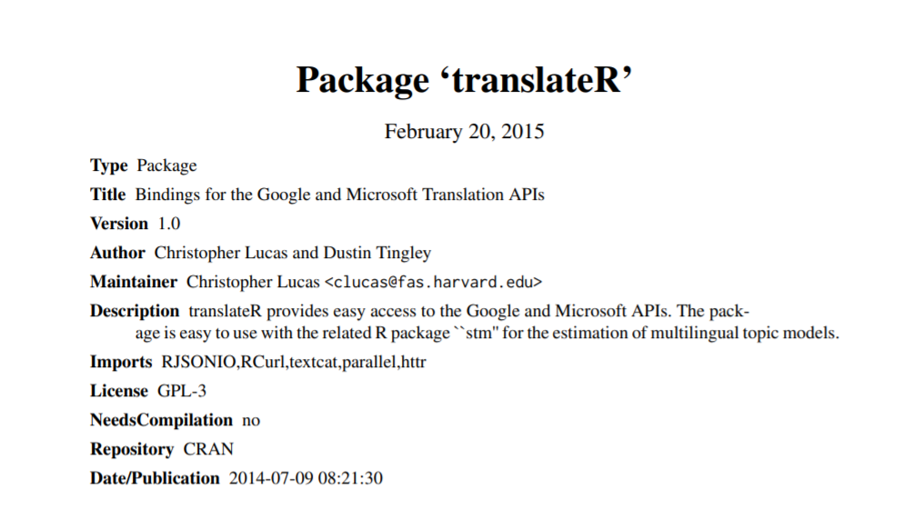
Translate with R
data<- translate(dataset = data_1,
content.field = 'Q10', google.api.key = my.api.key,
source.lang = 'ge', target.lang = 'en')

Slide 9
Translate with R
data<- translate(dataset = data_1,
content.field = 'Q10', google.api.key = my.api.key,
source.lang = 'ge', target.lang = 'en')

Slide 10
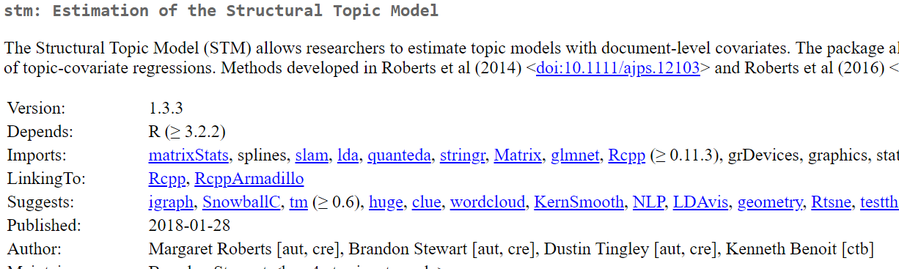
Topic modeling in R

Slide 11
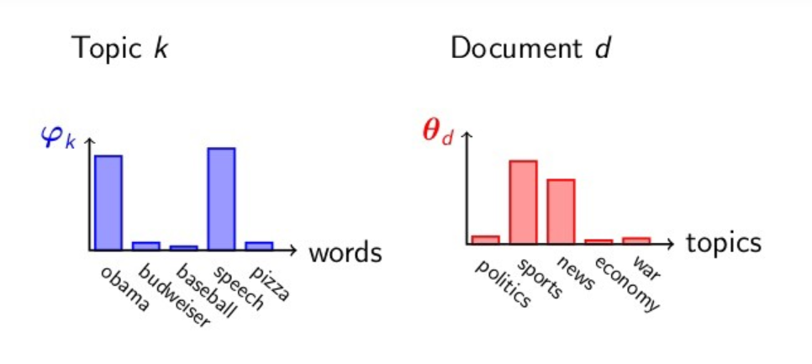
Topic modeling in R
Source: https://towardsdatascience.com/latent-dirichlet-allocation-15800c852699

Slide 12
Topic modeling in R
library(stm)
library(tm)
library(NLP)
processed <- textProcessor(data$10, metadata = data)
processed <- textProcessor(data$Q10, metadata = data)
out <- prepDocuments(processed$documents, processed$vocab, processed$meta)
docs <- out$documents
vocab <- out
mod.out <- stm(out$documents, out$vocab, 15, data=out$meta)
plot(mod.out)
B<-data.frame(t(labelTopics(mod.out, n = 15)$prob))
write.csv(B, "q10.csv")

Slide 13
Topic modeling in R
library(stm)
library(tm)
library(NLP)
processed <- textProcessor(data$10, metadata = data)
processed <- textProcessor(data$Q10, metadata = data)
out <- prepDocuments(processed$documents, processed$vocab, processed$meta)
docs <- out$documents
vocab <- out
mod.out <- stm(out$documents, out$vocab, 15, data=out$meta)
plot(mod.out)
B<-data.frame(t(labelTopics(mod.out, n = 15)$prob))
write.csv(B, "q10.csv")

Slide 14
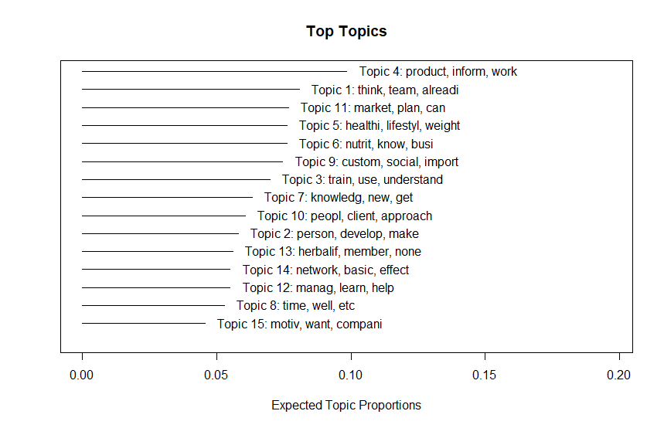
Results

Slide 15
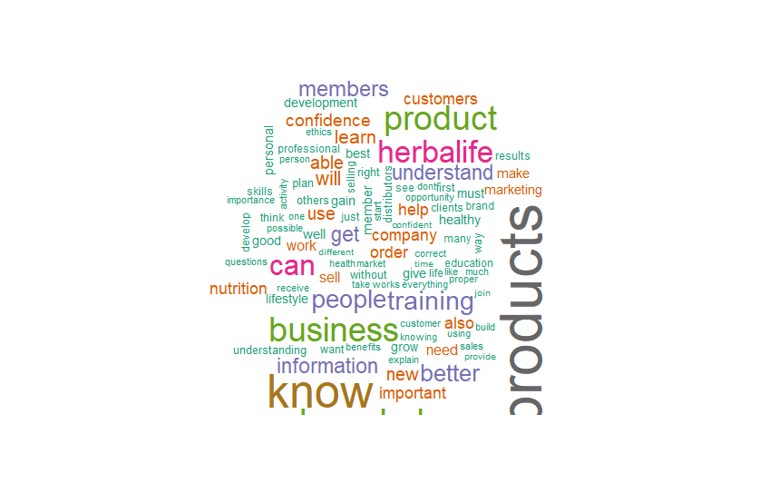
Results

Slide 16
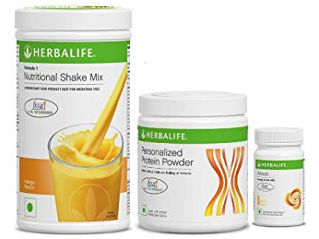




Results
 | To learn about products „To use the product properly. Know all of the Herbalife products. And tell people about supper product and cosmetics.” |  | To learn about company „To understand the philosophy and mission of the company. People don’t understand what exactly is Herbalife, someone just signed without thinking.”
 | To become a professional seller „To become a professional in the business. Become a personal consultant on nutrition.” |  | To be more confident and competent „Personal development and confidence in their actions, correct behavior in attracting customers.”
 | To learn about healthy lifestyle „To understand how to lead a healthy life, to understand what it is all about - healthy lifestyle and why you need it.”
Q. Why should Members receive compulsory training when they first join Herbalife Nutrition? N= 479.
RSM Education & Training Survey

